Slide 1

Custom Bootcamp - IDA
Smriti Ravindran

Slide 2
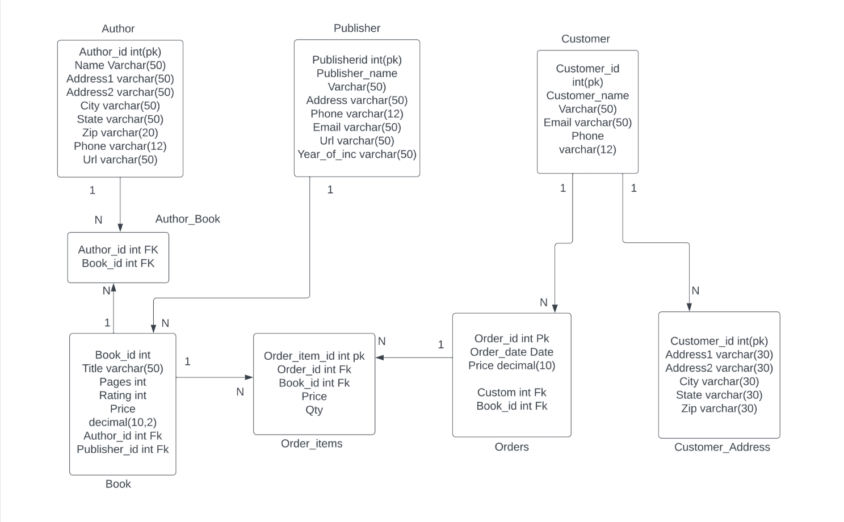
Database and Management Systems

Slide 3
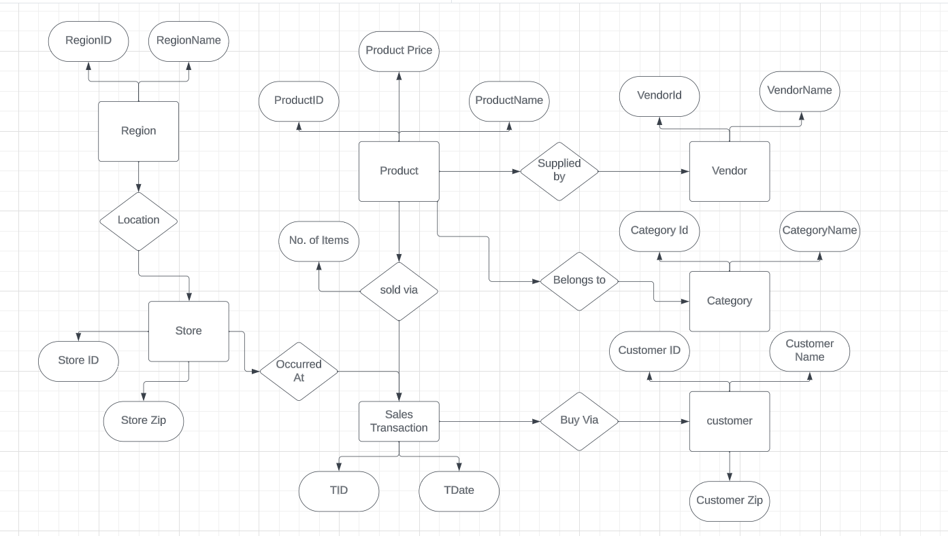

Slide 4
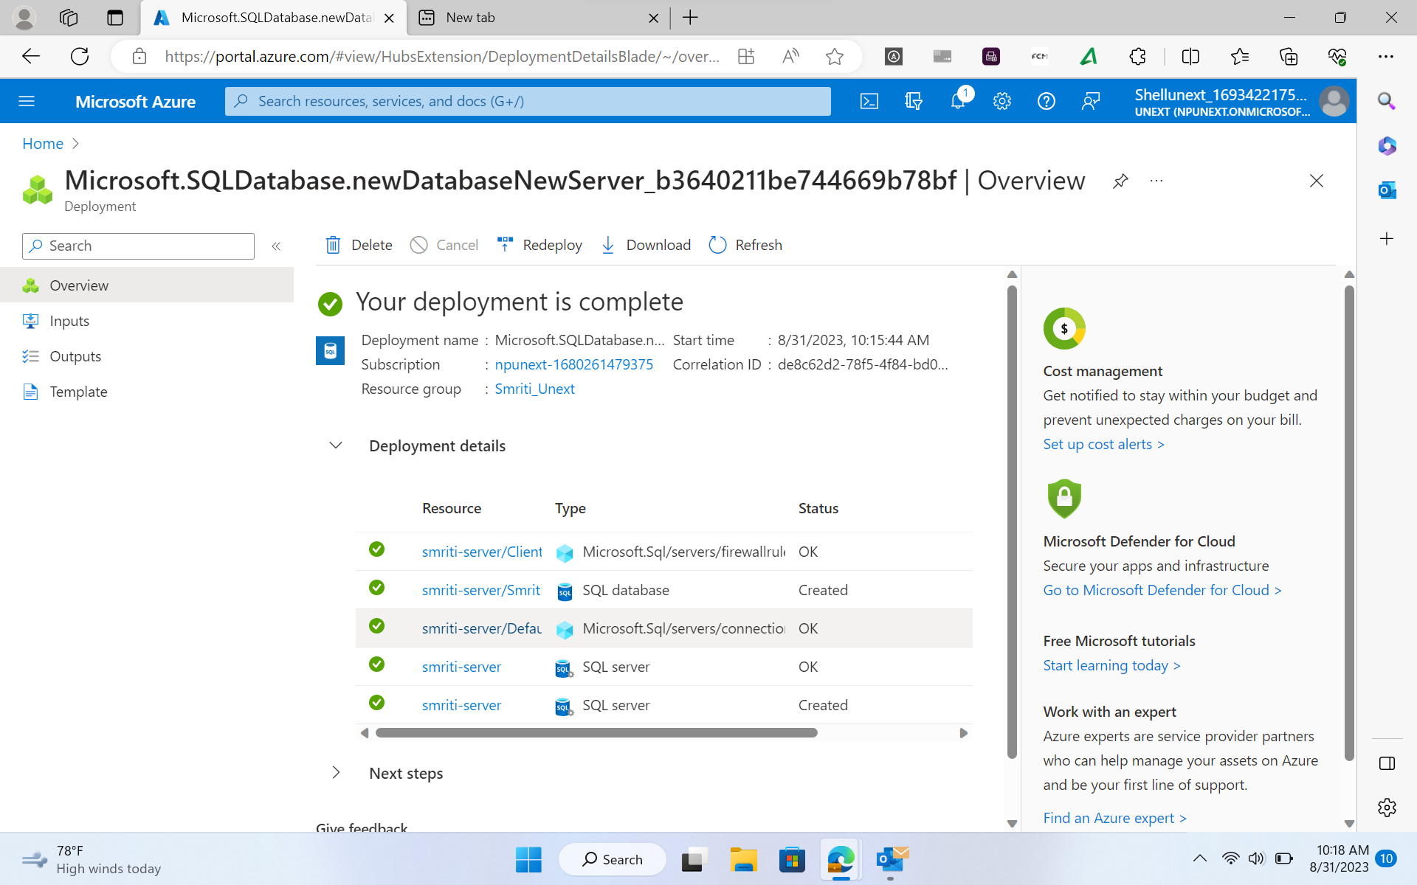
Deployment of an SQL server using Microsoft azure services

Slide 5
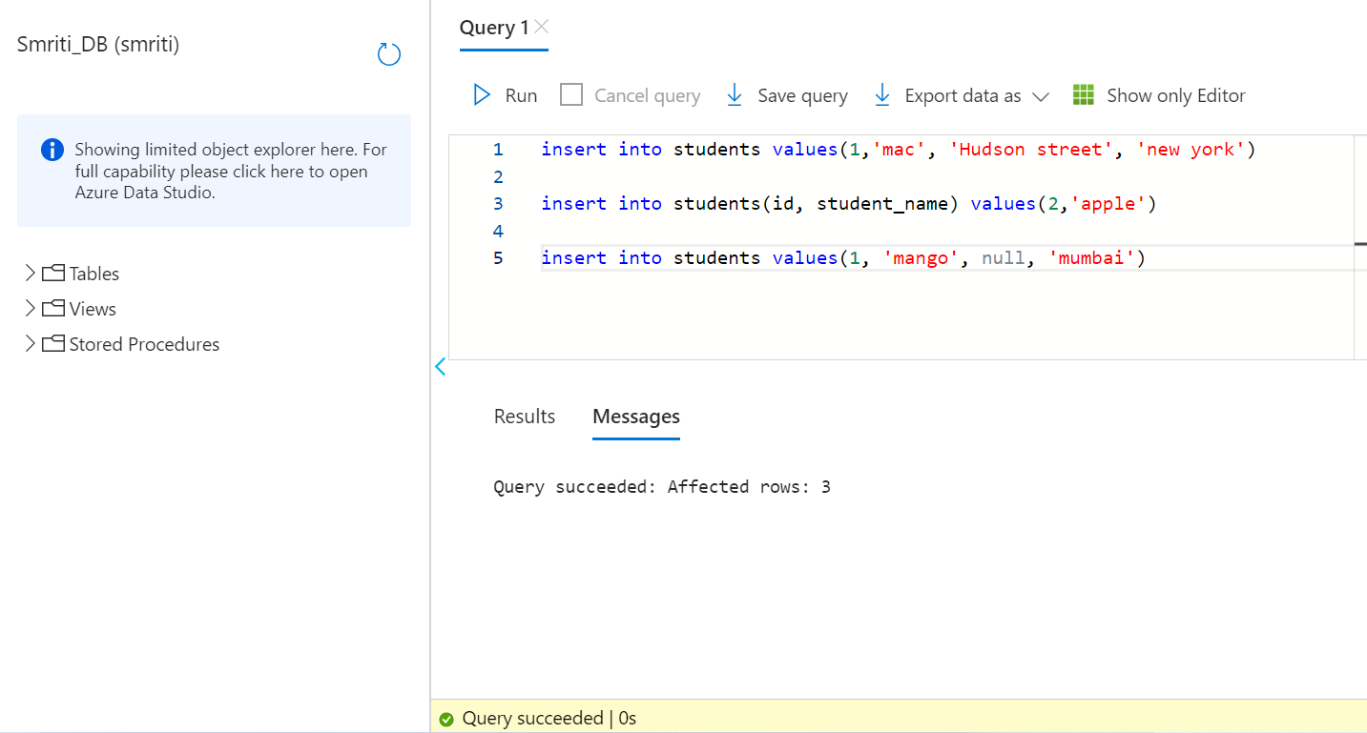
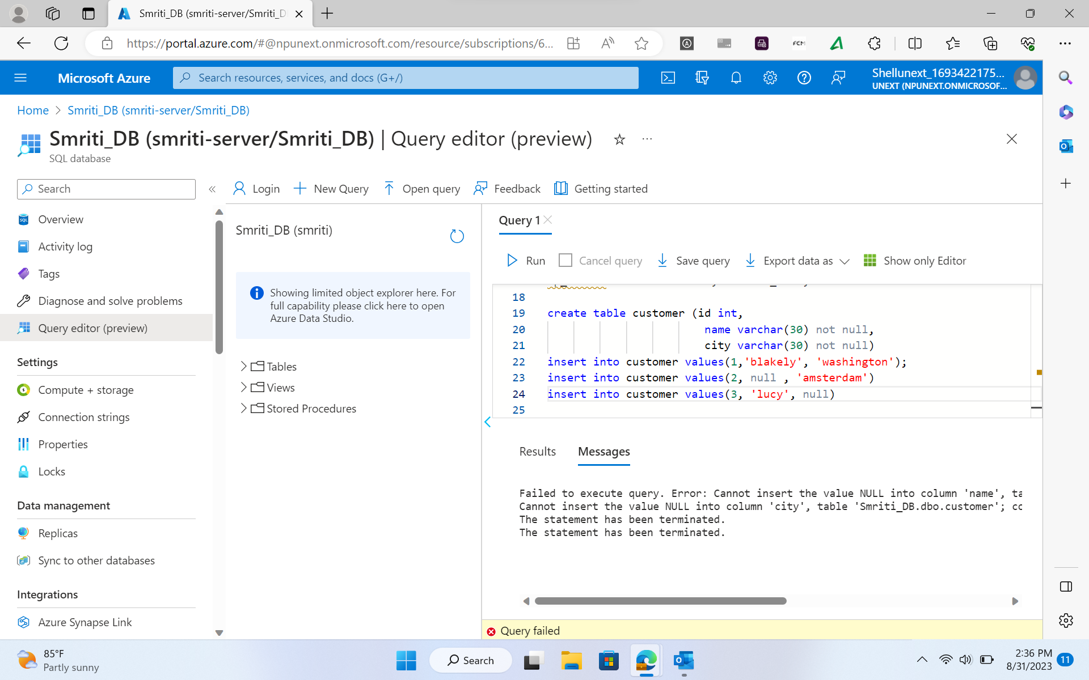
Created Tables over the SQL server, inserted different types of attributes and run queries.

Slide 6

